Slide 1


Nikita IVANOV
Founder, Apache PMC
Apache Ignite - In-Memory Data Fabric
Beyond the Data Grid
#apacheignite
www.ignite.apache.org

Slide 2
Agenda
Project history
In-Memory Data Fabric
Advanced Clustering
In-Memory Compute Grid
In-Memory Data Grid
In-Memory Service Grid
In-Memory Streaming & CEP
Plug-n-Play Hadoop Accelerator

Slide 3
In-Memory Data Fabric
Strategic Approach to IMC
Supports Applications of various types and languages
Open Source – Apache 2.0
Simple Java APIs
1 JAR Dependency
High Performance & Scale
Automatic Fault Tolerance
Management/Monitoring
Runs on Commodity Hardware
Supports existing & new data sources
No need to rip & replace

Slide 4
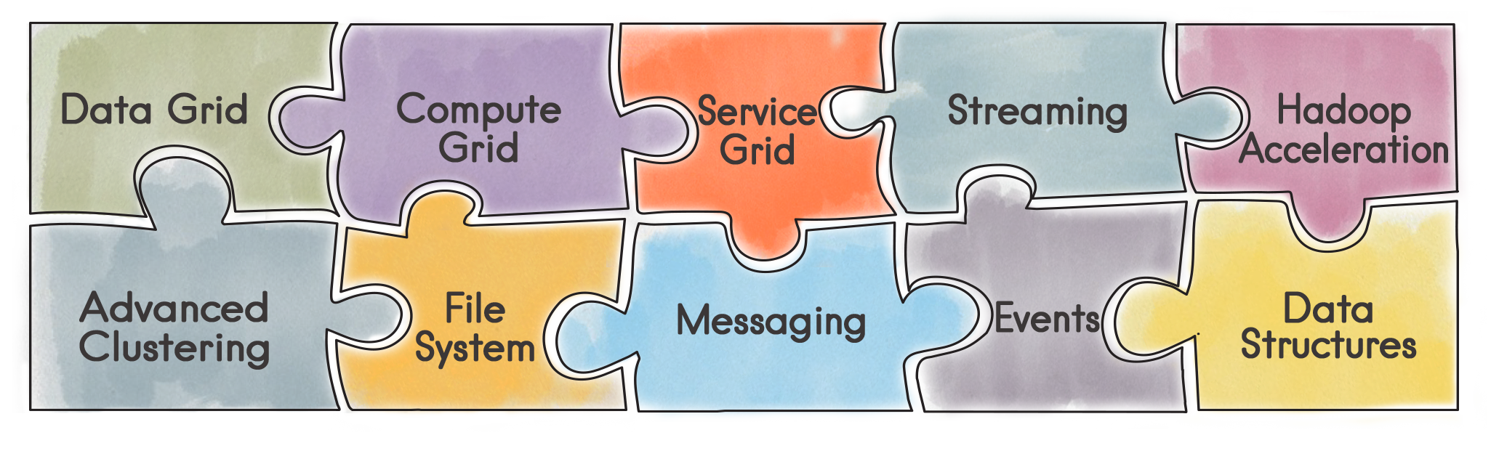
In-Memory Data Fabric
Main Characteristics
Performance
High Throughput
Low Latencies
Scalability
Add Cluster Members (cores)
Add Memory (RAM)
High Availability
Data Backups
Datacenter Replication
Transactions
Fully ACID Compliant
Optimistic & Pessimistic
Persistence
SQL, NoSQL, Hadoop
Security
Authentication
Authorization
Tracing & Auditing
Notes:
Direct API for Fork/Join

Slide 5

In-Memory Clustering & Deployment
Ease of Getting Started
Automatic Discovery
Any Environment
Public Cloud
Private Cloud
Hybrid Cloud
Local Laptop
Zero-Deployment
Auto-Deploy Code
Full Cluster Management
Pluggable Design
Notes:
Direct API for Fork/Join

Slide 6
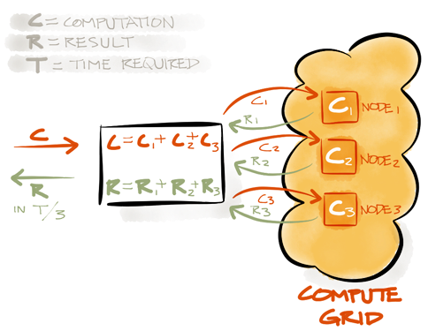
In-Memory Compute Grid
Direct API for MapReduce
Zero Deployment
Cron-like Task Scheduling
State Checkpoints
Load Balancing
Automatic Failover
Full Cluster Management
Pluggable SPI Design
Notes:
Direct API for Fork/Join

Slide 7
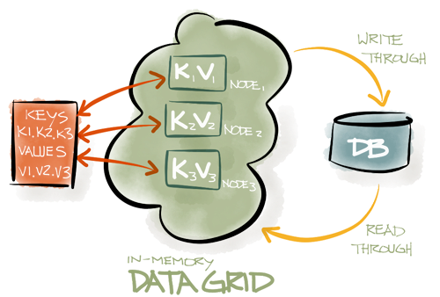
In-Memory Data Grid
Distributed In-Memory Key-Value Store
Replicated and Partitioned data
TBs of data, of any type
On-Heap and Off-Heap Storage
Highly Available In-Memory Replicas
Automatic Failover
Distributed ACID Transactions
SQL queries and JDBC driver
Collocation of Compute and Data

Slide 8
In-Memory Data Fabric: Off-Heap Memory
Unlimited Vertical Scale
Avoid Java Garbage Collection Pauses
Small On-Heap Footprint
Large Off-Heap Footprint
Off-Heap Indexes
Full RAM Utilization
Simple Configuration

Slide 9
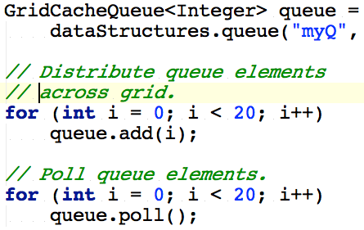
Distributed Java Structures
Distributed Map (cache)
Distributed Set
Distributed Queue
CountDownLatch
AtomicLong
AtomicSequence
AtomicReference
Distributed ExecutorService

Slide 10
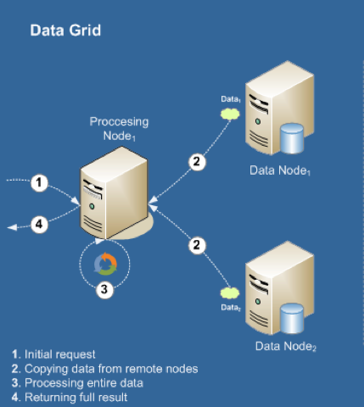
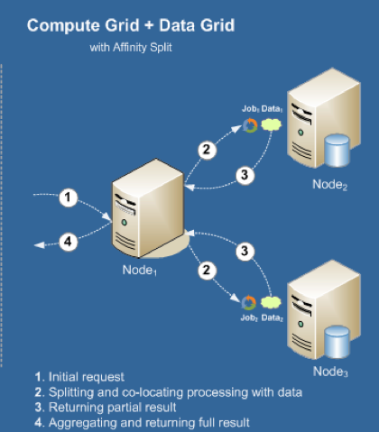
Client-Server vs Affinity Colocation
Client-Server
Affinity Colocation

Slide 11
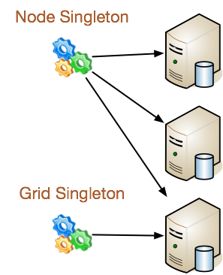
In-Memory Service Grid
Distribute Any Data Structure
Available Anywhere on the Grid
Automatic Remote Access via Proxies
Controlled Deployment
Support for Cluster Singleton
Support for Node Singleton
Support for Custom Topology
Load Balanced
Guaranteed Availability
Auto Redeployment in Case of Failures
Notes:
Direct API for Fork/Join

Slide 12
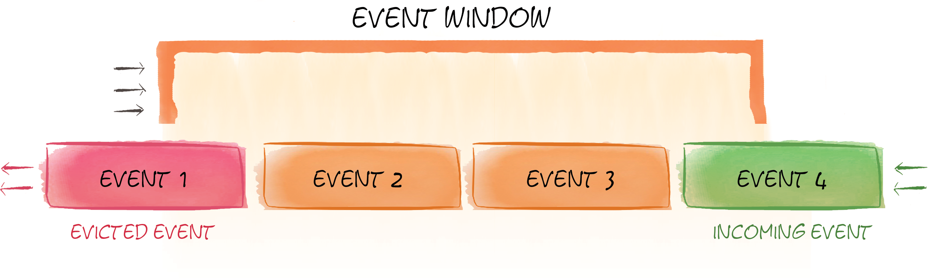
In-Memory Streaming and CEP
Streaming Data Never Ends
Branching Pipelines
Pluggable Routing
Sliding Windows for CEP/Continuous Query
Real Time Analysis

Slide 13
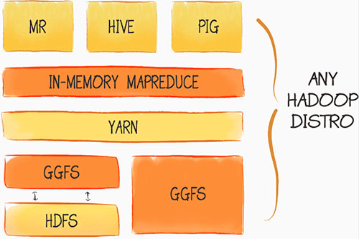
In-Memory Hadoop Accelerator
Plug and Play installation
10x to 100x Acceleration
In-Memory Native MapReduce
In-Process Data Colocation
IgniteFS In-Memory File System
Read-Through from HDFS
Write-Through to HDFS
Sync and Async Persistence

Slide 14
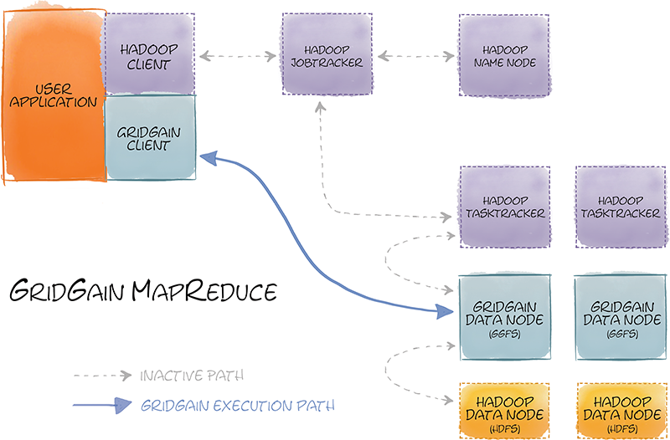
In-Memory Hadoop Accelerator
Zero Code Change
In-Memory Native Performance
Use existing MR code
Use existing Pig/Hive queries
No Name Node
Eager Push Scheduling

Slide 15
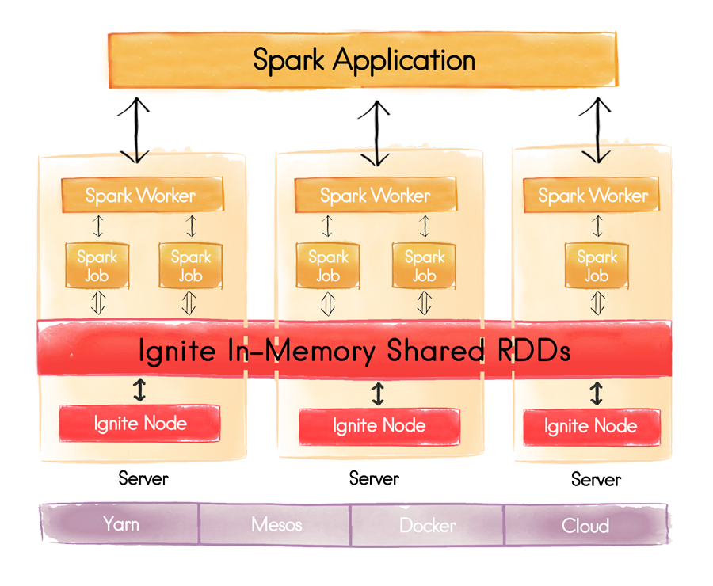
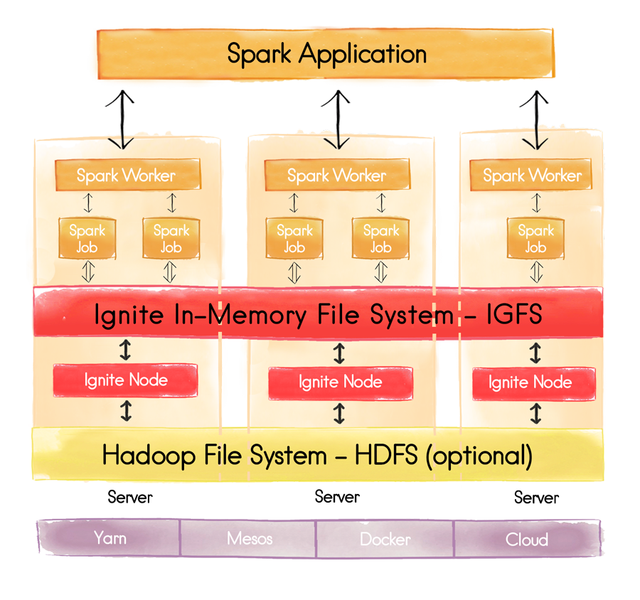
Spark Integration – IGFS & Shared RDD

Slide 16
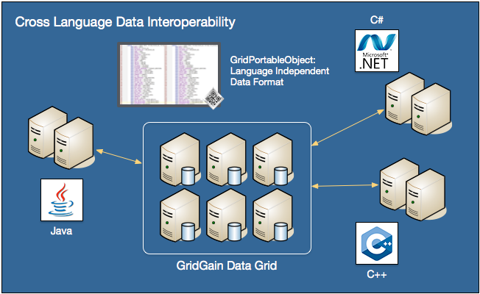
Cross-Language Interoperability
C++/.NET/PHP/Java/Node.js
Portable Objects
Performance Across Languages
Client Feature Parity
Dynamic Schema Changes
Searchable/Indexable
Version Independent

Slide 17
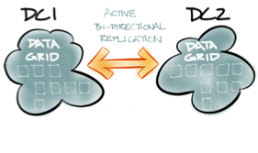
In-Memory Data Fabric: Data Center Replication
Up to 32 Data Centers
Active-Active & Active-Passive
Smart Conflict Resolution
Durable Persistent Queues
Automatic Throttling
Enterprise Edition Only

Slide 18
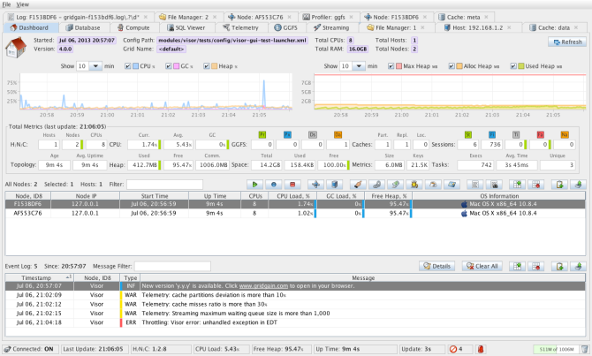
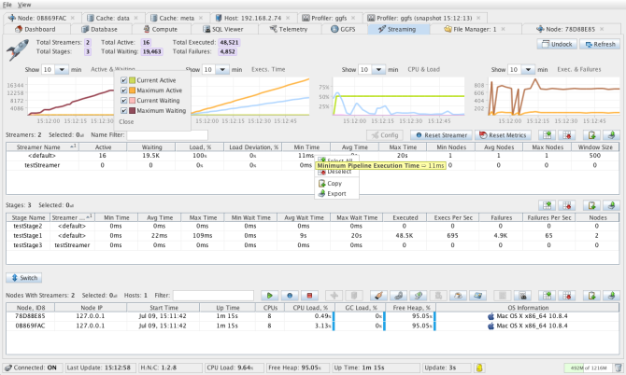
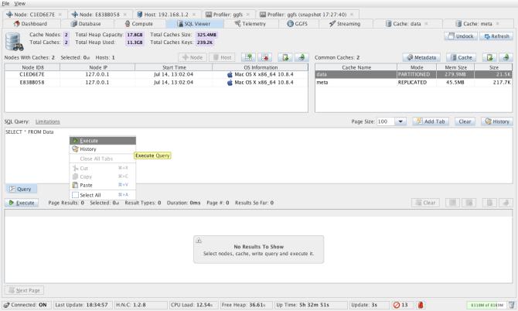
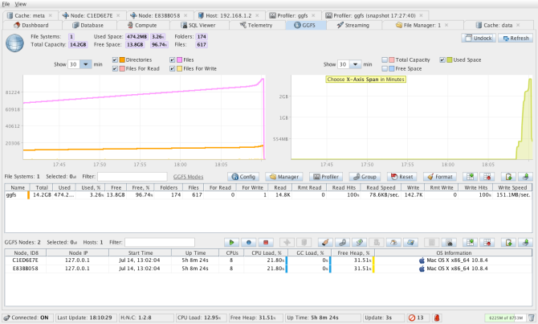
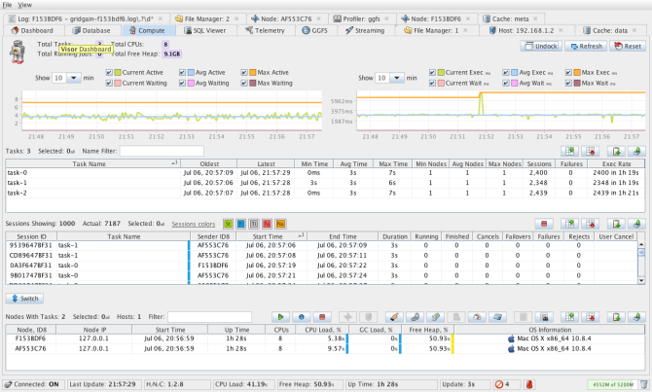
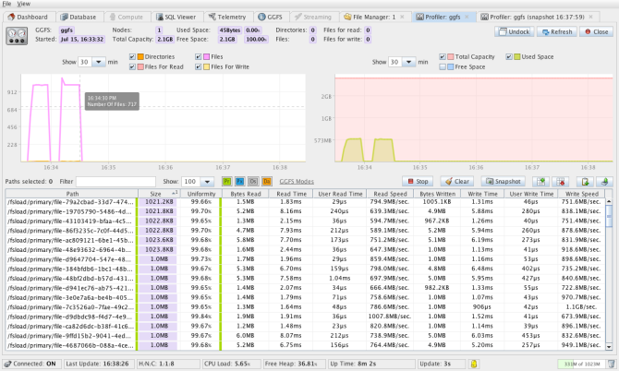
Management & Monitoring
Enterprise Edition Only

Slide 19
Local Restartable Store
Persistent On-Disk Store
Fast Recovery
Local Data Reload
Eliminate Network and Db impacts when reloading in-memory store
Enterprise Edition Only

Slide 20
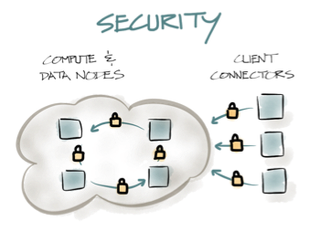
In-Memory Data Fabric: Security
Pluggable Auth & Auth
JAAS, LDAP, JNDI, Kerberos
In-Cluster Node Authentication
Client Authentication
Secure Client Sessions
Fine-Grained Authorization
Comprehensive Auditing
Who? What? When?
Enterprise Edition Only
Notes:
Direct API for Fork/Join

Slide 21
Thank YOU!
#apacheignite
www.ignite.apache.org

